Slide 1
James 4:7 – 7 Submit therefore to God. Resist the devil and
he will flee from you.
Resisting Satan
Old Spanish Trail church of Christ
4/14/19

Slide 2
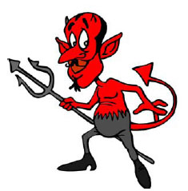
Satan
What picture comes to mind when you think of Satan?
Do these pictures help or hinder our understanding of his nature?

Slide 3
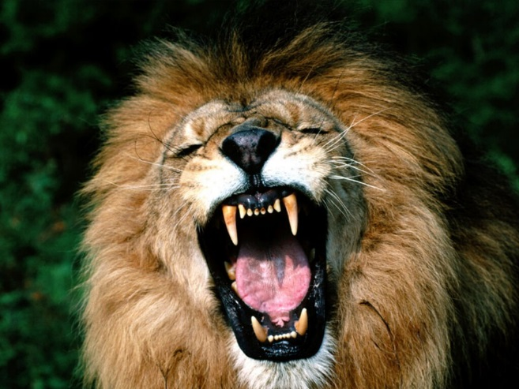
Our enemy
1 Peter 5:8
8 Be of sober spirit, be on the alert. Your adversary, the devil, prowls around like a roaring lion , seeking someone to devour.
Does Satan want us to fear him or embrace him? Or both or neither?

Slide 4
The Spiritual Battle
Ephesians 6:10-13
10 Finally, be strong in the Lord and in the strength of His might. 11 Put on the full armor of God, so that you will be able to stand firm against the schemes of the devil. 12 For our struggle is not against flesh and blood, but against the rulers, against the powers, against the world forces of this darkness, against the spiritual forces of wickedness in the heavenly places. 13 Therefore, take up the full armor of God, so that you will be able to resist in the evil day, and having done everything, to stand firm.

Slide 5
The Spiritual World
We tend to struggle with belief of the spiritual world
Ghosts, spirits, séances, psychics, etc.
Let’s not confuse our doubt of certain aspects of the paranormal or what the world calls “the spiritual world” with what the Bible says about it
They aren’t (necessarily) the same thing

Slide 6
The Spiritual World
The spiritual world existed first
Job 38:4-7, Genesis 1:1, John 1:1-3
It will outlast the physical world
Luke 20:34-36, 2 Peter 3:10, most of 1 Corinthians 15

Slide 7
The Battleground
This spiritual battle takes place in the “heavenly places”
Ephesians 6:12
Ephesians 1:3, 20; 2:6; 3:10
Hebrews 12:22-24
Is this battle a present or future battle?
Is this a realm where we actively participate while still in the physical world?
Who else operates in this spiritual realm?
Does all of this sound a little weird?

Slide 8
The Stakes
What is Satan fighting for in this spiritual battle?
John 12:31, 1 John 5:19
What happens at the end of the battle?
Matthew 25:41 indicates eternal fire
Why is Satan fighting for this world and souls now if he will be condemned at the end of time?
He’s evil and wants to take whoever he can with him

Slide 9
Satan’s Tactics
How does Satan draw men away from God?
Lusts of the flesh, appeals to our carnal nature (Ephesians 2:2-3)
Demands opportunity to test us (Luke 22:31)
Blinding us to the truth (2 Corinthians 4:3-4)
Tempting us (1 Thessalonians 3:5)
Plain old lying to us (Genesis 3:1, Matthew 4:8-9)
Disguising himself as angel of light (2 Corinthians 11:14)

Slide 10
Satan’s Tactics
Drill down on the lying, tempting
John 8:44 – Satan is the father of lies
2 Corinthians 11:13-15 – Disguises himself as an angel of light; his servants disguise themselves as servants of light
1 Timothy 4:1-5, Matthew 4:5-9 – False doctrine that sounds good on the surface
One of Satan’s best tricks to lure away believers is to pretend to be a man of God and present half-truths as God’s truth!

Slide 11
Fighting our own civil war
We have a battle within ourselves because we want to do God’s will, but we also want to do our own will
Galatians 5:16-18 and Romans 8:5-9
What sort of fruit do we bear doing God’s will?
Galatians 5:22-23
What sort of fruit do we bear doing our own will?
Galatians 5:19-21

Slide 12
Fighting the world
We also wage a war against the world
2 Corinthians 10:3-6
The nature of the world stands opposed to God
1 John 2:15-17; James 4:2-4
Satan uses it with devastating effect against us
1 John 5:19; Ephesians 2:1-2

Slide 13
The battle is set, the lines are drawn
The greatest trick the devil ever pulled was convincing the world he didn’t exist
Satan is a terrible enemy, but the one who is in us “is greater than he who is in the world” (1 John 4:4)

